Slide 1


FIM 2010 Visualizing the Synchronization Configuration Triple
Henry Schleichardt
Thomas Herbst
infoWAN Datenkommunikation GmbH

Slide 2
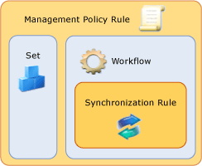
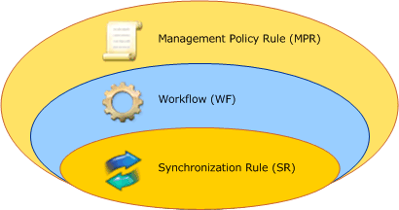
The Triple in MS Documentation
http://technet.microsoft.com/en-us/library/ee534902(v=ws.10).aspx
http://technet.microsoft.com/en-us/library/ff608273(v=ws.10).aspx

Slide 3
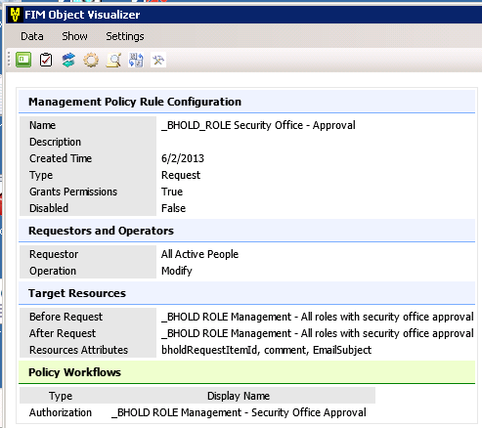
Object Visualizer View
Still missing:
Set Membership Criteria
Set Transition Criteria
Data can only be copied not saved and only one by one
http://fimov.codeplex.com/

Slide 4
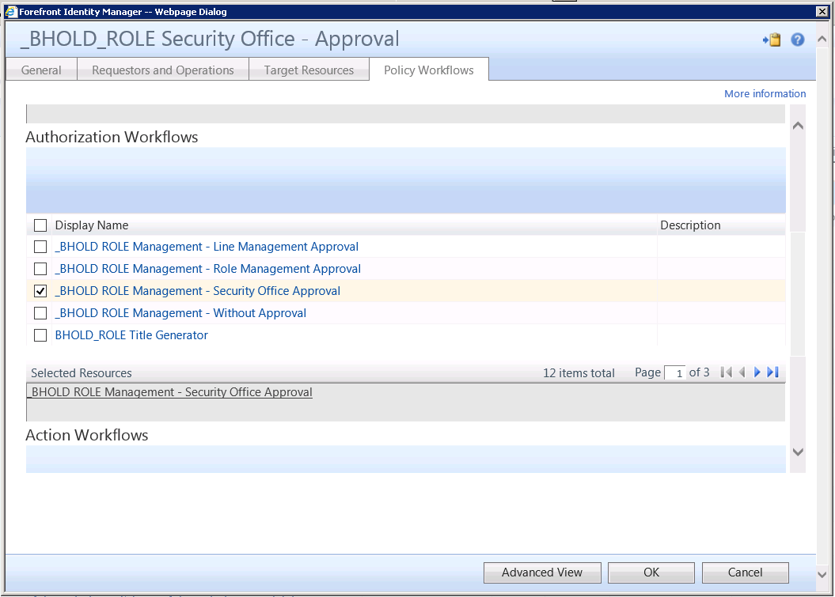
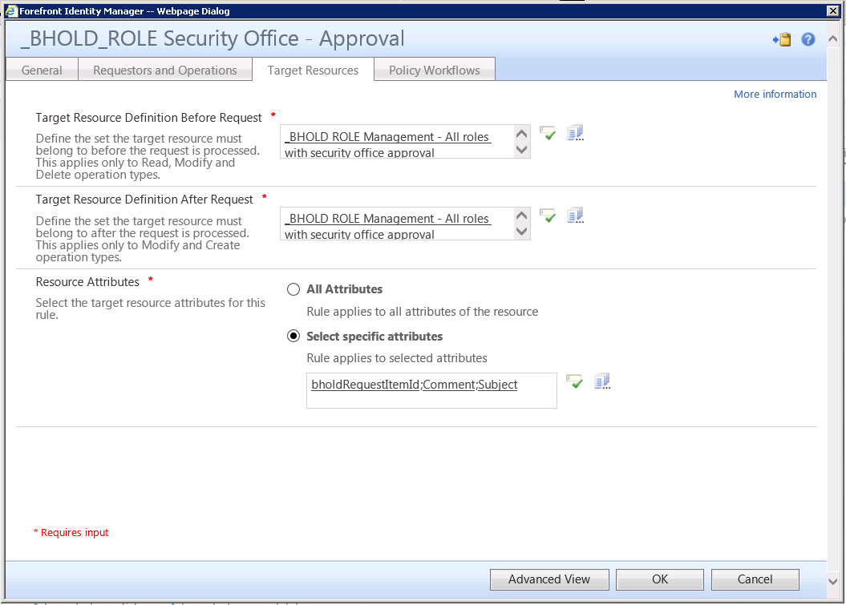
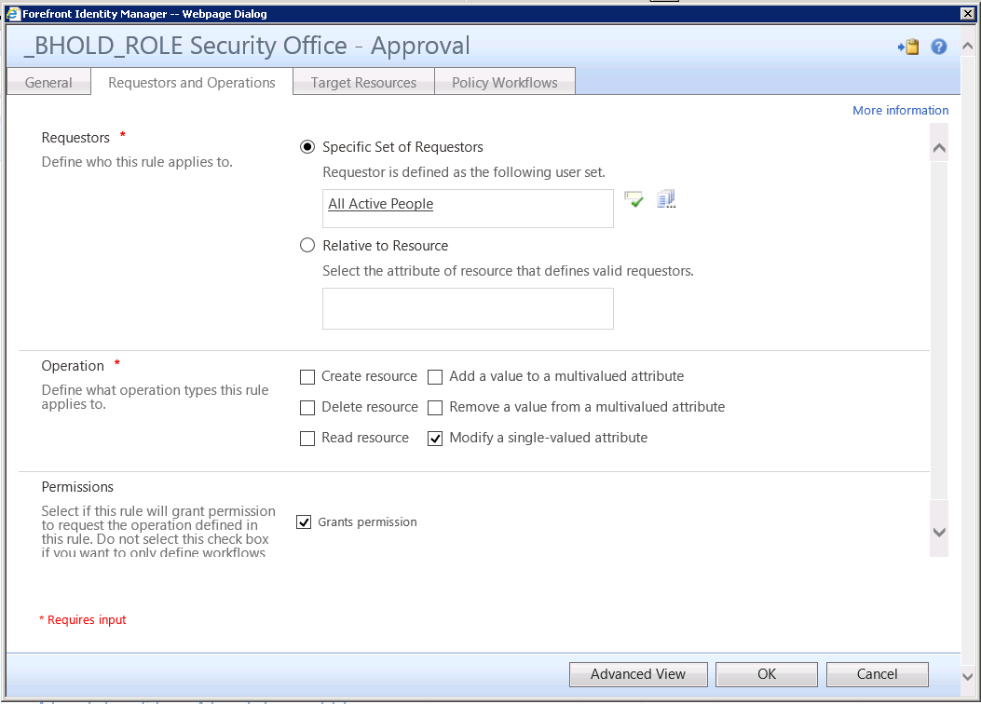
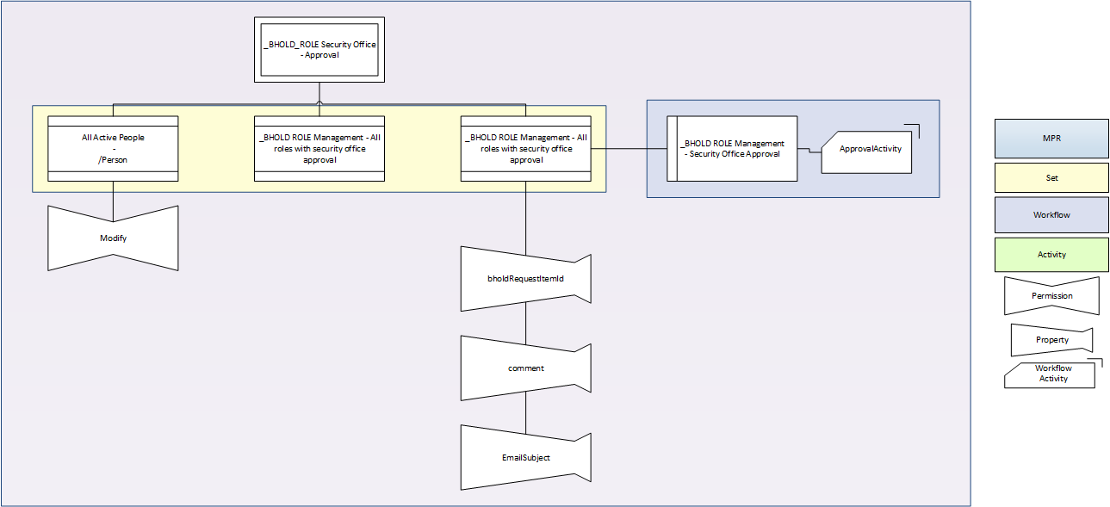
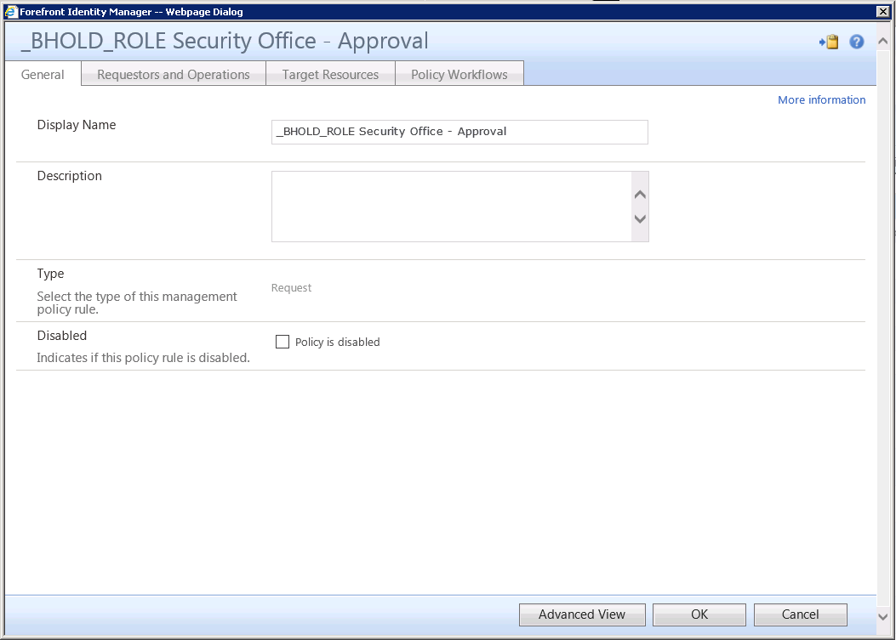
The Triple in Production

Slide 5
Our Need
MRP usage not considered (permission or action or both)
Multiple Sets may be involved as Requestor or Target
Set Membership in Sets is not considered
Multiple Workflows are possible
Workflows do not only trigger Sync Rules
Better explaination of dependencies of MPR, SETs, Workflows within Triple
More Details of these objects
Source XML as kind of backup

Slide 6
Two Step Documentation
Step 1
Export Configuration
Define Filter if desired
Exports all MPRs included in the Filter
Keeps track of Sets and Workflows used in these MPRs
Exports Details of all Sets and Workflows used in MPRs above
Step 2
Visualization of the MPRs using VISIO http://visioautomation.codeplex.com/
Exporting all drawings as .png

Slide 7
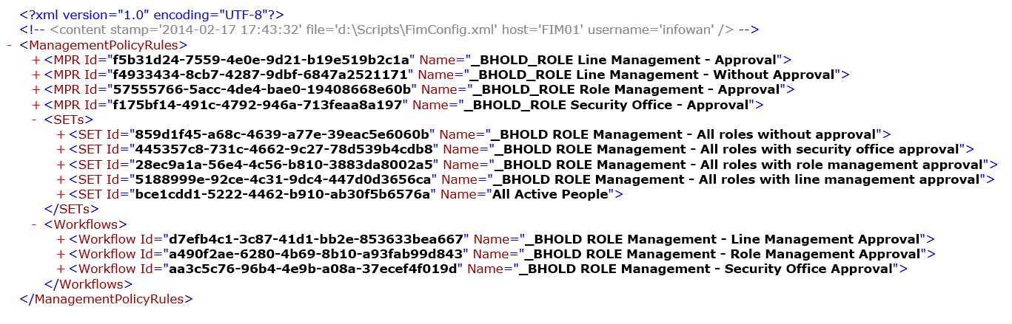
Step 1: Export Configuration
FimConfigToXml.ps1
Define Search Filter
Set-Variable -Name objectPrefix -Value “_BHOLD_"
$allMpr = export-fimconfig ` -uri "http://localhost:5725/resourcemanagementservice" `
-customconfig ("/ManagementPolicyRule[(starts-with(DisplayName,'$($objectPrefix)')) and (Disabled = 'False')]") ` -onlyBaseResources
Format of the XML Export

Slide 8
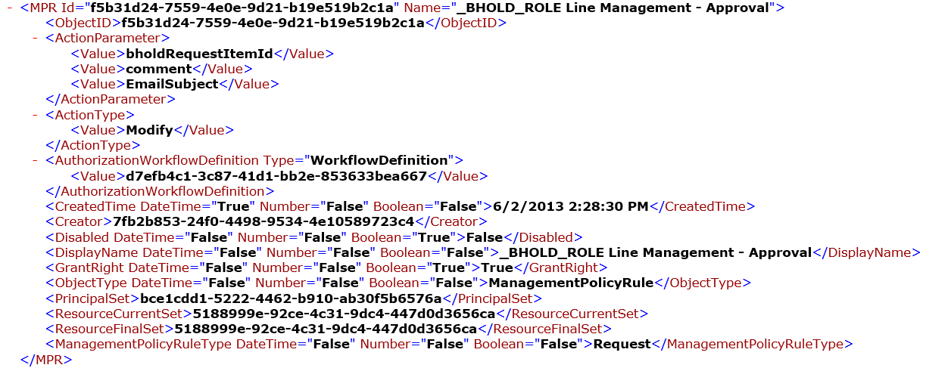
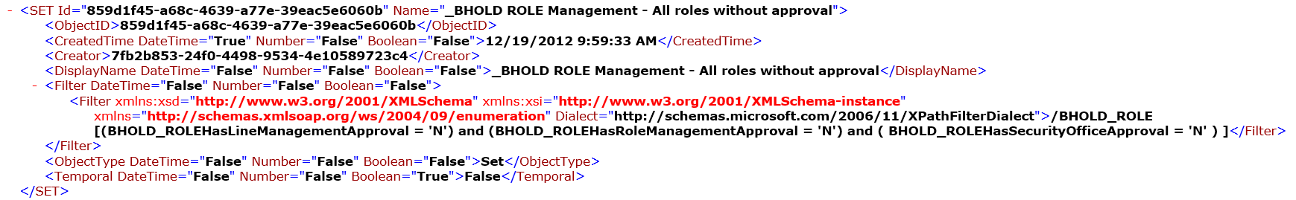
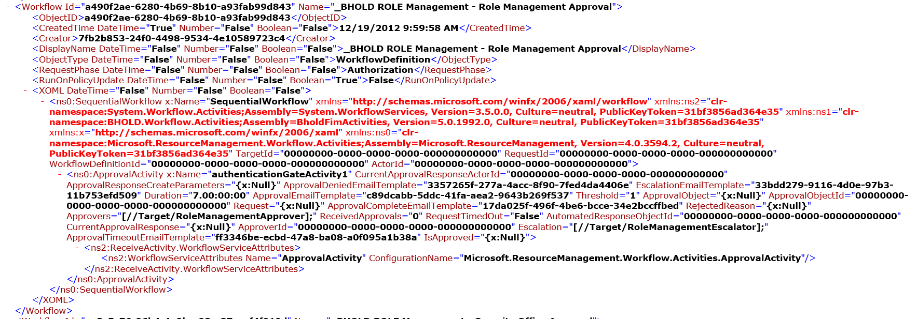
Step 1 continued
Details of a MPR
Details of a Workflow
Details of a Set

Slide 9
Step 2 Visualization of the MPRs
XMLtoVisio.ps1
Prerequisites
Visio must be installed
Visio COM object access through Powershell using „VisioAutomation“ http://visioautomation.codeplex.com/ http://viziblr.com/news/2013/3/8/automating-visio-with-powershell-visiops-11-released.html
Custom Stencils (copied to „%userprofile%\documents\my shapes\FIMVisio.vss“)
Tested on Win7/8/8.1 and Visio 2013 English
Provide Path Values at the Beginning of the Script

Slide 10
Step 2 continued
Script Part 1
Prepare Script Environment and set global variables
Script Part 2
Prepare Visio Environment
Script Part 3
Parsing the XML output from Step 1
Script Part 4
Call „GenerateVisio“ Function

Slide 11


Know Issues
Connecting Shapes is not as expected in any case * „AutoConnect“ has a Parameter „Down“ but it connects left or right in some cases * „Auto“- Parameter connects in a circle around the current Object sometimes
Long strings used in descriptive fields or XPATH filters
Language issues (only tested with English Office Version)
Developed using Office 2010 and 2013
Custum stencils are used
Positioning of Stencils depends on Alignment Properties not accessible via Powershell
Dependency on Culture de-DE in string and DateTime operations
Usability is limited to our goals.
More Details are possible but may be difficult to display in our choosen format.

Slide 12
Demo

